Slide 1
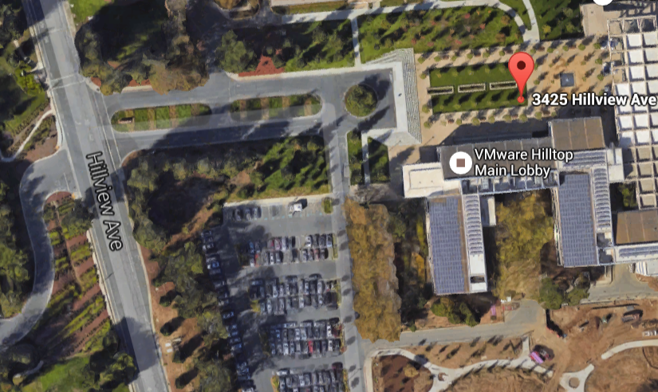
3425 Hillview Ave (Hilltop A Lobby)
Entrance
Onsite Contact:
Matthew Ament
Cell: 1-408-796-8056
Matt Ament will collect WWC members from the lobby and escort to the conference room
Park Here

